Slide 1
Peer Stakeholder-Product Validation Review (PS-PVR) GOES-19 GMAG L1B Provisional Certification User Perspective
01/24/2025
NOAA NWS Space Weather Prediction Center (SWPC)
Howard Singer
Acknowledgements:
NCEI Space Weather Group and all the Organizations and People contributing to the GOES-19 Magnetic Field Observations

Slide 2
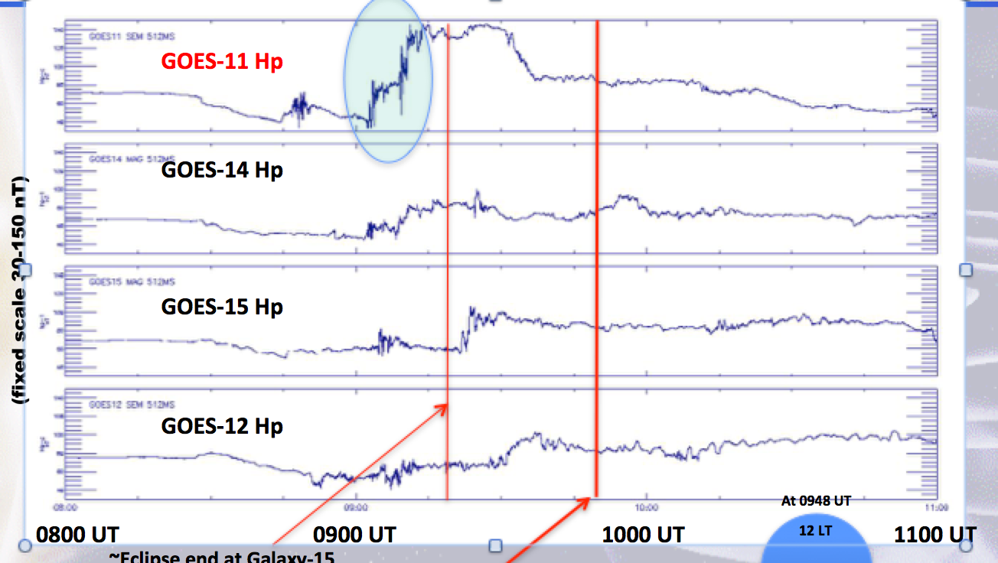
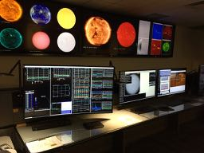
Operational Uses of the GOES-R Series Magnetometer Data An Essential Measurement for Current and Future Space Weather Operations
National Space Weather Action Plan identifies the geostationary magnetic field as one of the baseline observations required for space weather operations
Space Weather Prediction Center
Space Weather Forecast Office
GOES Magnetometer and Particle Data
GOES 11 Magnetometer Data
Key to Understanding 8-month Galaxy 15 Outage

Slide 3
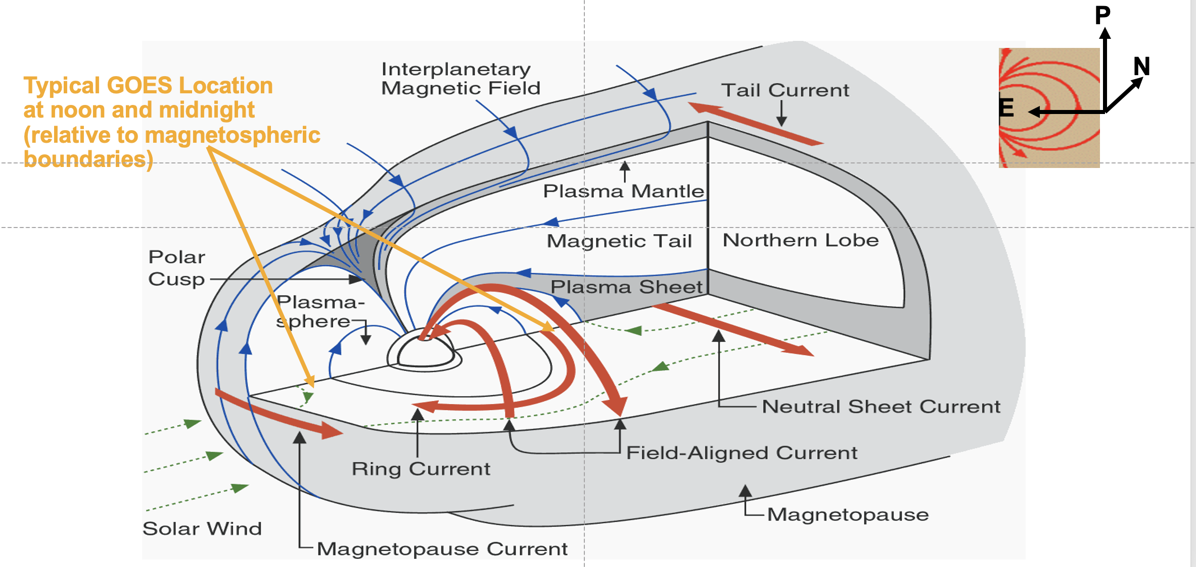
The GOES Magnetometer Measures all the Key Current Systems in the Magnetosphere
That Influence Space Weather
SOLAR WIND – INDUCED ELECTRIC CURRENTS
FLOWING IN THE MAGNETOSPHERE

Slide 4
Magnetometer Operational Use Summary
Providing forecasters and the public with situational awareness of the level of geomagnetic disturbances
Contributing to energetic particle products that use the orientation of the magnetic field for specifying the radiation belts and using in radiation belt models supporting satellite users
Utilizing for real-time, operational validation of the Geospace model that supports power grid operations
Detecting magnetopause crossings and alerts for the detection of solar wind shocks and sudden impulses at Earth
Supporting sounding rocket launch decisions
Conducting research for understanding the space environment and producing future products
Developing techniques for new operational applications (e.g. wave-particle interactions needed by radiation belt models)
Providing data to NESDIS NCEI archives and one of the most used data sets by the scientific community (through NCEI and NASA)

Slide 5
Magnetometer Measured Impacts at Earth Some Examples
Solar Wind Shocks and Sudden Impulses
When these impact Earth, large disturbances in Earth’s magnetic field can cause geomagnetically induced currents (GICs) in power grids
Forecasters use DSCOVR to give warnings, but GOES magnetometer shows impact at Earth and contributes to alerts
Magnetopause Crossings
Satellite operators have utilized GOES magnetometer data to understand when their satellite, normally in Earth’s magnetosphere, is located in an extremely different plasma and field environment (e.g. affects on torquer coils)
Storms and Substorms
Forecasters use changes in the orientation of the geosynchronous observed magnetic field as an indication of the potential for the release of stored energy and subsequent injections of energetic particles that can cause spacecraft charging and particle precipitation into the auroral zone affecting HF radio wave propagation
Satellite Anomalies
GOES-11 magnetometer data were key to understanding the environmental conditions related to the 8-month outage of Galaxy 15

Slide 6
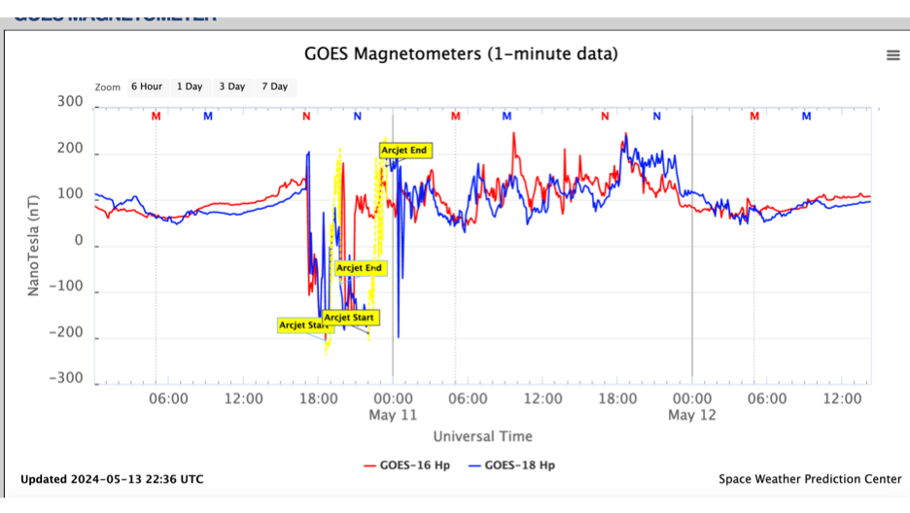
GOES-16 & -18 Operational Magnetometer Data
During the Gannon “G5” Geomagnetic Storm
May 10-11, 2024
The geomagnetic storm that initiated on May 10, 2024 was observed by the GOES-16 and -18 magnetometers and signaled potential impacts on technological systems.

Slide 7
GMAG Performance Highlights
and Recommendations
GMAG (outboard and inboard) is performing extremely well, meeting key requirements
GMAG is greatly improved from earlier instruments in the GOES-R series with respect to characteristics such as bias offset determination, noise level, lack of s/c, heater, and A/D converter noise/interference
Consideration of sensor orthogonality to demonstrate agreement between GMAG 1 and 2 is excellent work
GMAG is well-suited for use in the community and operations with the following considerations:
SWPC supports transitioning of GMAG to Provisional status
Additionally, SWPC recognizes the need for continued data stewardship and concurs with NCEI plans for:
Continuing to pursue promising methods for arcjet corrections
Bias stability monitoring
Product use and development

Slide 8
SWPC is greatly appreciative of the work and contributions provided by NCEI, as well as the support provided by the NASA program and NASA GSFC, NOAA, LM and the entire GOES project.
Contact : howard.singer@noaa.gov

